Slide 1


Production technology, moral hazard & costs
John Horn

Slide 2
Practical application
Economic concept
Practical business application
Production technology
Operations research
Standard operating procedures (SOP)
Isoquant
What are the different ways we can hit our production goals?
Marginal product
Optimizing production
Scale economics
Expansion plans
Moral hazard
Are we incentivizing “bad” behavior?

Slide 3
Agenda
Production technology
Marginal product
Scale economies
Moral hazard

Slide 4
Firms’ choices
To achieve its objectives, a firm chooses:
Inputs
Labor (High-skill, low-skill)
Capital (Machines, computers, buildings…)
Other (Raw materials, land…)
Outputs
What goods and services to produce
Quantities of each output
Constraints
Technology
Economic constraints from input and output markets

Slide 5
Production technology
Definition
A firm’s technology specifies a quantitative relationship between combinations of inputs and the level of output
Important aspects
Marginal product
Factor substitution
Economies of scale
Short and long run
Ways to describe
Function
Graph
Table

Slide 6



Production technology: Examples
...
Given 10 hours of labor, a factory, a specific collection of machinery and parts, how many washing machines are generated?
2 eggs, ¼ cup of milk, ¼ tsp each of salt and pepper, a whisk, a pan, a heat source, and 10 minutes of labor to make 1 serving of scrambled eggs
The last example should make clear it is hard to describe production fully without having to include a ton of detail
Notes:
http://www.coca-cola.com/global/, Public domain, via Wikimedia Commons (https://commons.wikimedia.org/wiki/File:Coca_Cola_Logo.jpg)
Haier, Public domain, via Wikimedia Commons (https://commons.wikimedia.org/wiki/File:Haier_logo.svg)
Photo by Annushka Ahuja: https://www.pexels.com/photo/a-person-cooking-scrambled-eggs-8055161/

Slide 7
Production technology
Economists simplify to a single output and two inputs
Labor (L)
Can be varied immediately
Need more to produce one more unit
“Variable inputs”
Capital (K)
Can’t change immediately
Don’t need more to produce one more unit
“Fixed inputs”
What is variable and fixed changes over time

Slide 8



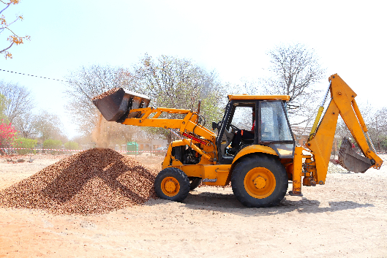

“Simple” example
Labor
Capital
Capital
Labor
Notes:
Mictlancihuatl, CC BY-SA 4.0 <https://creativecommons.org/licenses/by-sa/4.0>, via Wikimedia Commons (https://commons.wikimedia.org/wiki/File:International_Workcamp_in_Schenkenzell.jpg)
Photo by Anastasia Shuraeva: https://www.pexels.com/photo/a-man-digging-in-the-forest-8926955/
Alupus, CC BY-SA 3.0 <https://creativecommons.org/licenses/by-sa/3.0>, via Wikimedia Commons (https://commons.wikimedia.org/wiki/File:Three_shovels.JPG)
Photo by Roger Brown: https://www.pexels.com/photo/yellow-front-loader-at-construction-site-5125783/
Gary J. Wood from Toronto, ON, Canada, CC BY-SA 2.0 <https://creativecommons.org/licenses/by-sa/2.0>, via Wikimedia Commons (https://commons.wikimedia.org/wiki/File:Water_Main_and_Faucet_(3681464688).jpg)

Slide 9
Production functions
General form: Q = f(L,K,…)
f(L,K)
Amount of Q that comes out when L and K go in
Assumption
f(L,K) tells us maximum quantity
Flexible
Easily tailored to include other types of inputs or a greater number of them

Slide 10
Production functions: Examples
Utility produces electricity (kWh) from coal and/or natural gas
Each ton of coal (C) produces 60 kilowatt hours
Each 100 cubic meters of gas (G) produces 40 kilowatt hours
Production function: Q = 60C + 40G
Number of insurance claims processed in a day
Q = K^{1/2}L^{1/2} = $\sqrt{KL}$
K = total computer power, L = # of claims workers
If K = 2, L = 2: Q = 2
K = 9, L = 1: Q = 3
K = 9, L = 4: Q = 6

Slide 11
Production technology
Can describe production technology with a table:
L K | 1 | 2 | 3 | 4 | 5
1 | 20 | 40 | 55 | 65 | 75
2 | 40 | 60 | 75 | 85 | 90
3 | 55 | 75 | 90 | 100 | 105
4 | 65 | 85 | 100 | 105 | 115
5 | 75 | 90 | 105 | 115 | 120
90
90
90
There are several ways to produce 90 units of output

Slide 12
Illustrating production technology
We can also draw lines called isoquants that show the variety of ways that certain output goals can be achieved
K
These lines are contours, like on a weather or topographical map
3
2
Q = 90
Q = 75
Q = 60
2
3
L

Slide 13
Illustrating production technology
Example:
Return to the electricity production function: Q = 60C + 40G
Draw the isoquant for 1,200 kWh of the electricity production technology
G
C

Slide 14
Illustrating production technology
Example:
Return to the electricity production function: Q = 60C + 40G
Draw the isoquant for 1,200 kWh of the electricity production technology
(Set 1,200 = 60C + 40G and plot)
G
30
Where do the intercepts come from?
What does the slope of the isoquant mean?
20
C

Slide 15
Agenda
Production technology
Marginal product
Scale economies
Moral hazard

Slide 16
Marginal product
Marginal product of labor (MPL)
What is the extra output from adding another unit of L, holding K fixed?
L | K | Q | Q/L | dQ/dL (MPL)
0 | 10 | 0 | - | -
1 | 10 | 10 | 10 | 10
2 | 10 | 30 | 15 | 20
3 | 10 | 60 | 20 | 30
4 | 10 | 80 | 20 | 20
5 | 10 | 95 | 19 | 15
6 | 10 | 108 | 18 | 13
7 | 10 | 112 | 16 | 4
8 | 10 | 112 | 14 | 0

Slide 17
Marginal product
L | K | Q | Q/L (APL) | dQ/dL (MPL)
0 | 10 | 0 | - | -
1 | 10 | 10 | 10
2 | 10 |  | 15 | 20
3 | 10 | 60 | 20
4 | 10 | 80 |  | 20
5 | 10 |  | 19 | 15
6 | 10 | 108 | 18
7 | 10 | 112 |  | 4
8 | 10 |  | 14 | 0

Slide 18
Marginal product
MPL
Calculated for a given amount of capital!
Assume first increase and then decrease as L goes up
Marginal product of labor (dQ/dL)
APL
Average product of labor (Q/L)
Law of Diminishing Returns
MPL eventually goes down
Extra units of labor increase output at a decreasing rate
Another relationship
If MPL > APL then APL is going up
If MPL < APL then APL is going down

Slide 19
Marginal and average product
Average Product of Labor
“Labor Productivity”
Useful for international productivity comparisons
Short run concept
What are the main determinants of this?
What determines productivity growth in services, agriculture?
Marginal, Average Products of Capital
Can define the same concepts for capital (K)
K is flexible relative to L in the long run

Slide 20
Illustrating productivity
For any production function, we can illustrate MPL and/or APL, given a level of K
Q
MPL APL
MPL
APL
L
L

Slide 21
MPL as K varies
For higher levels of K, we will observe higher levels of MPL
MPL
MPL₁ is associated with a low level of K
MPL₂ is associated with higher level of K
MPL₂
Notice the bigger gap at high L than low L
MPL₁
L

Slide 22
Example: China
Why is China’s labor productivity slowing down?
Why is this a problem?
Explain: “China needs to focus on getting more out of its available resources, rather than relying on rapid capital accumulation”
Why does Rabobank recommend:
Improving education
Bolstering intellectual property protections
Chinese companies spending more on R&D
Source: “China Has World’s Biggest Productivity Problem,” Bloomberg, May 11, 2017

Slide 23

Factor substitution and long-run production
Various L and K can lead to the same Q when inputs are substitutable
This follows from MPL > 0 and MPK > 0 (Why?)
Marginal Rate of Technical Substitution (MRTS)
Slope of an isoquant
$MRTS=−\frac{MPL}{MPK}$
K
Interpretation
Holding Q fixed, how much K is the firm willing to give up for one more unit of L?
Q = 10
L

Slide 24
Substitution between factors
Are we sure MRTS is the slope of the isoquant?
MPx is the change in output if input x goes up or down by a small amount
If L increases by dL, then Q increases by
MPL x dL
If K decreases by dK, then Q falls by
– MPK x dK
In general ...
dQ = (MPL x dL) + (MPK x dK)
True for dL and dK being (+) or (–)
Since we are moving along an isoquant, we are interested in dQ = 0
Insert this and rearrange to get:
Slope of the isoquant
MPL
dK
—
=
MPK
dL

Slide 25
Variation in factor substitution
When K is high and L is low, MRTS may be high
Remember MRTS = -MPL/MPK
Managerial relevance: Flexibility in changing inputs depends on their initial mix and the inherent characteristics of production technology
K
1
|MRTS₁| > |MRTS₂| because of differences in labor and capital productivity
2
Q = 10
L

Slide 26
Agenda
Production technology
Marginal product
Scale economies
Moral hazard

Slide 27
Scale economies
A firm’s efficiency may depend on how large it is
High output for relatively low inputs
Example: 3 restaurants – Which is most efficient?
Small: 1 chef; small kitchen
Must do everything
Limited equipment
Medium: 10 chefs; kitchen (10x Small)
Tasks divided
Saves time for all
Specialized capital
More than 10x the output of Small
Large: 100 chefs; huge kitchen (10x Medium)
Fine division of tasks
Requires a lot of coordination
No additional benefits from specialized capital
Less than 10x the output of Medium

Slide 28
Scale economies defined
We measure scale economies by asking how much output increases if inputs increase by some factor (e.g., double)
If inputs double …
K
Constant returns to scale
Double the output
16
More than double the output
Increasing returns to scale
Q = ??
8
Q = 10
Decreasing returns to scale
Less than double the output
8
16
L

Slide 29
Scale economies in the real world
Most real-world technologies are believed to have
Increasing returns to scale (RTS) for low Q
Decreasing RTS for high Q
Why shouldn’t we expect to observe many increasing RTS situations at firms’ observed sizes?
General intuition
In long-run equilibrium, we should expect firms to operate at their most efficient scale
Coffee shops are small and auto plants are huge

Slide 30

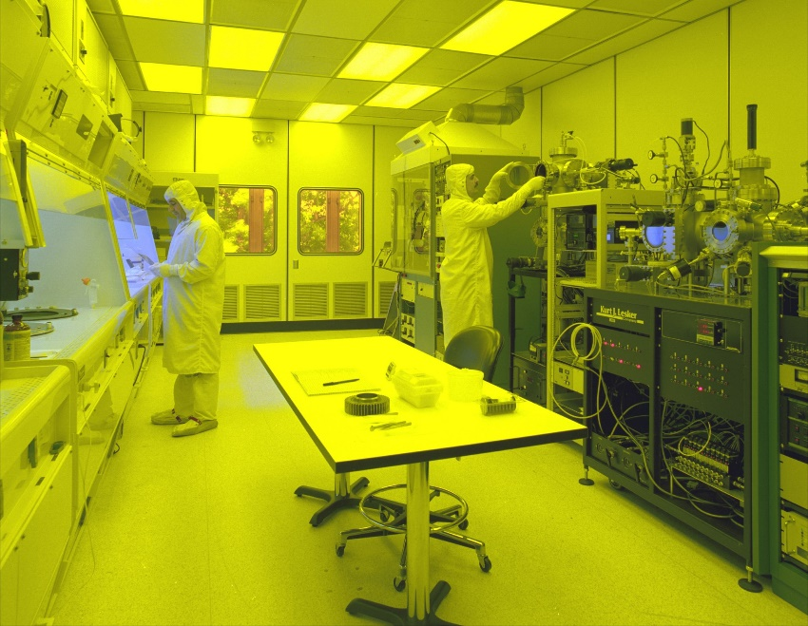
Scale economies example
Micro-processor production
Decreasing RTS
Microprocessors produced in clean “fabs”
Fabs are often the same size
Increasing returns for very small fabs, but as fabs get larger is it difficult to keep them clean and organized
TSMC has many fabs
Notes:
Arusanov, Public domain, via Wikimedia Commons (https://commons.wikimedia.org/wiki/File:Tsmc_factory_hsinchu.JPG)
Uploaded by Duk 08:45, 16 Feb 2005 (UTC), Public domain, via Wikimedia Commons (https://commons.wikimedia.org/wiki/File:Clean_room.jpg)

Slide 31
U.S. manufacturing dominated by small plants

Slide 32
Short run vs. long run
We conclude with long run v. short run adjustments
Firm has K₁ units of capital today
K
Production goal just shifted from Q = 10 to Q = 20
How will you achieve the new goal?
K₁
For what types of production technology do you think it will be easiest/hardest to achieve Q = 20?
Q = 20
Q = 10
L₁
L₂
L
Think of the dashed lines as different technologies

Slide 33
Examples of behavioral biases: Production
Status quo bias
Tendency to want things to stay the same
Related to loss aversion and the endowment effect
“This is working fine, and if we change, who knows how bad it’s going to get?”
Law of the instrument
Over-reliance on familiar tools
“If all you have is a hammer, everything looks like a nail”
Not invented here
Resistance to using knowledge or processes or products developed outside of the organization
“That may work for our competitors, but it would never work with us”

Slide 34
Agenda
Production technology
Marginal product
Scale economies
Moral hazard

Slide 35
Moral hazard
Definition
When one party is fully insured, and it cannot be monitored fully by the insurer, the insured party’s behavior may change after the insurance has been purchased
The insured party can affect the probability or magnitude of the event that triggers the insurance payment
Example: car warranties
In the Lemons model, a warranty can signal high quality
Solves pre-contractual adverse selection problem
Does this create a moral hazard problem?

Slide 36
Example: Car warranties
Buyer is more likely to break the car when he has a warranty
Seller will have pay more to service the warranty
How could the seller deal with this situation?
Would ideally like to fully monitor the buyer, and only pay out in situations that are not the result of careless actions by buyer
This is costly and impossible to do …
Because seller cannot monitor buyer, seller doesn’t know whether breakdown because of poor maintenance, or because car was in bad shape
Seller would like a warranty contract where buyer’s interest is to take care of the car

Slide 37
Example: Health insurance
M = quantity of healthcare services
P = price
C = co-insurance rate (< 100%)
When consumers pay fully out of pocket, use M₁
When consumers only pay C*P, increase demand to M₂
Increase in demand reflects moral hazard
Also creates deadweight loss to society
$
P
C*P
M₁
M₂
M

Slide 38
Example: Health insurance
Individuals with health insurance no longer have same incentives to purchase healthcare services as if they faced the full price
Generates a moral hazard problem
What are the implications of covering the uninsured?
Why should high deductible health plans restrain costs?

Slide 39
Summary
We have covered
How to describe a production technology
Important details:
Marginal and average productivity
Scale economies
This will be useful to us because...
Firms costs follow directly from productivity
Changes to firms’ organizational strategies depend on the possible production technologies

Slide 40
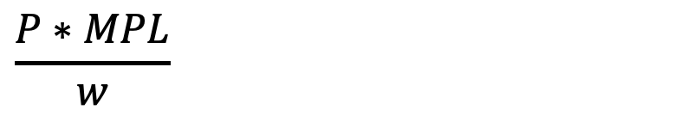

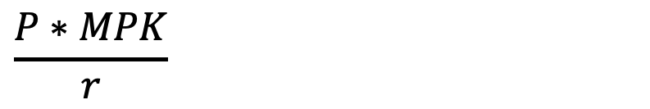
Practical application
Economic concept
Practical business application
Isocost
Budget
$$\frac{P∗MPL}{w}$$
Return on “labor”
Gross (contribution) margin
$$\frac{P∗MPK}{r}$$
Return on investment
Return on invested capital
Return on equity
Return on assets
$$\frac{MPL}{w}=\frac{MPK}{r}$$
Economic value added
Return on investment
Economies of scale
Optimizing business unit sizes

Slide 41
Agenda
Describing costs
Short-term costs
Long-term costs
Key cost types

Slide 42
Two areas where economists and accountants disagree
Economic costs
Costs relevant for decision-making
Accounting costs
Costs actually incurred
Two primary differences
Opportunity costs (or real/economic costs)
Sunk costs

Slide 43
Opportunity/real costs
Opportunity costs
Resources spent on one opportunity cannot be spent on another
Foregone (net) benefits from best alternative opportunity (not taken) must be counted as economic cost
May or may not be immediately obvious what counts
Included by economists (excluded by accountants)
Examples
Self-employment and own wages
Expense of flying versus driving
Keeping money in a savings account

Slide 44
Sunk costs
Sunk costs
Must be paid regardless of a person’s or firm’s action
Ignored by economists; included by accountants
Why sunk costs don’t matter
Consider two possible actions, X and Y, each with its own revenue (R) and economic cost (C)
Sunk cost (S) regardless of action taken
Compare total return:
R_{X} – C_{X} – S >=< R_{Y} – C_{Y} – S
Value of S won’t affect optimal choice, so ignore it
Examples
Building permits/licenses
Irreversible contracts

Slide 45
Describing costs
Goal
How do costs change as firm’s environment changes?
Two points of emphasis
Best way to understand firm’s production choices is to think about how it optimizes spending decisions
When firms have more flexibility in optimization, they can achieve their goals at lower expense
Thinking about expenditures on production inputs
Use a simple analogy/method
A firm spending $X on labor (L) and capital (K) is analogous to a household spending on fixed (e.g., mortgage) and discretionary (e.g., entertainment) items
Fixed costs are capital (K) spending in the short run
Variable costs are labor (L) in the short run, and both L and K in the long run

Slide 46
Input costs and isocost lines
Input prices
w: wage rate, or price per unit of labor (L)
r: rental rate per unit of capital (K)
Isocost
Many ways a firm can spend $C on L and K
Total spending = Spending on L + Spending on K
C = wL + rK
Example
Total spending (C) = $100
Wage (w) = $5 100 = 5L + 10K
Rental rate (r) = $10

Slide 47
Agenda
Describing costs
Short-term costs
Long-term costs
Key cost types

Slide 48
Optimal choices of inputs
We assume a firm will choose inputs (e.g., L and K) to maximize value
P*Q – w*L – r*K
Incremental benefit: Extra revenue from using one more unit of labor
Quantity from using one more unit of labor: MPL = dQ/dL
Extra revenue = P*(Extra Q) = P*MPL
Incremental cost: Extra cost from using one more unit of labor
Wage = w
Optimum where Incremental benefit (MB) = Incremental cost (MC)
P*MPL = w

Slide 49
What does P*(dQ/dL) = w mean?
dQ/dL
How output changes as we add labor, holding capital constant at K₁
Marginal product of labor
P*dQ/dL
Marginal Revenue Product of labor (MRP_{L})
Value of the Marginal Product of labor (VMP_{L})
Incremental revenue created by hiring an additional unit of labor
w
Incremental (or marginal) cost of an additional unit of labor
Implication
Firm should hire additional workers as long as the marginal revenue (benefit) created by the worker is greater than the marginal cost
Benefit of the last worker hired should just equal her cost

Slide 50
Implications for business strategy
Profit maximizing firm will choose L such that
P*(dQ/dL) = w
Or, MRP_{L} = w
Align the firm’s external (product/service market) strategy with its internal organizational (human capital management) strategy
Suppose firm wants to hire high quality, high wage workers, like MBAs
When would this make sense? (Hint: Use P*MPL(K₁) = w)
Can charge high prices
Has more productive workers
Uses more capital
Has better production technology

Slide 51
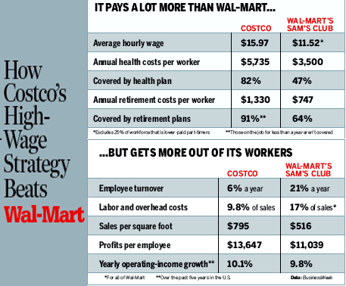
Example 1: Sam’s Club vs. Costco
Most workers don’t have health insurance
Many workers with no 401(k)
How can Costco survive?
51
Source: BusinessWeek, April 11, 2004, http://www.businessweek.com/stories/2004-04-11/graphic-how-costcos-high-wage-strategy-beats-wal-mart

Slide 52
Sam’s Club vs. Costco takeaways
Heterogeneity
Firms in same industry may have very different business and organizational strategies
Alignment
Organizational (HR) strategy must be aligned with product market strategy
Complementarity
Interactions between different choices (strategic, HR, supply chain, etc.) affect overall performance
Doing more of one choice increases the returns to doing more of another choice
Clear patterns of strategic and organizational practices that increase value when done together

Slide 53
Illustrating costs
Sample isocost: 100 = 5L + 10K
K
Characteristics of isocost lines:
Horizontal intercept is C/w (100/5)
Vertical intercept is C/r (100/10)
Slope is –(w/r)
10
-1/2
20
L

Slide 54
Illustrating costs
What happens when prices or total expenditures change?
K
Initial isocost: 100 = 5L + 10K
Sample initial (L,K) = (10,5)
Change #1:
New price of labor = 10
100 = 10L + 10K
Change #2:
Increase spending (to $150) so that can buy (L,K) = (10,5) again
150 = 10L + 10K
15
10
5
10
15
20
L

Slide 55
Short-run cost minimization
Your firm has the production function Q = LK
Capital (K) is fixed at 10 units in the short run
You are asked to produce 50 units of output
K
What is your best choice of L?
No real choice
For Q = 50, choose L = 5
Suppose w = 5 and r = 10
Cost of L = 5 and K = 10?
C = wL + rK
C = 5*5 + 10*10 = $125
Q = 50
10
C = $125
L
5

Slide 56
Lessons on short-run costs
Constraints
Constraints in one area (i.e., capital) lead to implicit constraints in other areas (i.e., labor)
Input prices
No role in selection of L and K to achieve the production goal
Once firm can choose each input, we should expect optimal choices to reflect input prices

Slide 57
Agenda
Describing costs
Short-term costs
Long-term costs
Key cost types

Slide 58
Optimal organization in long run
In long run, all inputs are variable, so we now consider choice of K, too
Value = P*Q – w*L – r*K
What is the correct choice of L and K?
Find optimal L same as before
P*(dQ/dL) = w
Choose L so that MRP_{L} = P*MPL = w = MC_{L}
Find optimal K by similar reasoning
P*(dQ/dK) = r
Choose K so that MRP_{K} = P*MPK = r = MC_{K}
What is the optimal allocation?

Slide 59

Optimal long-run input choice
Marginal rate of technical substitution (MRTS)
-MPL/MPK
Input price ratio
-w/r
=
Or …
$$\frac{MPL}{w}=\frac{MPK}{r}$$
Productivity per $ spent on K
Productivity per $ spent on L
Optimal input choice equalizes productivity per $ across inputs

Slide 60
Long-run cost minimization
Return to the example of Q = LK with K = 10 and input prices w = 5 and r = 10
Can we reduce spending when both L and K can be adjusted?
K
K is relatively expensive, yet the firm uses a large amount
Reduce K (arbitrarily) to 8, and select L = 6.25 so that Q = 50 and C = $111.25
Reduce K (optimally) to 5, and select L = 10 so that Q = 50 and C = 100
We pushed isocost inward while maintaining contact with isoquant
Q = 50
10
C = $111.25
8
C = $125
5
5
10
L
C = $100
6.25

Slide 61
Isocost tangent to isoquant
The firm’s best choice of inputs is where the isocost is tangent to the isoquant
They have the same slope
K
Q*
K* and L* are the cost-minimizing way to produce Q*
K₁ and L₁ also yield Q*, but at higher cost
K₂ and L₁ cost less than K* and L*, but do not yield the desired output
K₁
K*
K₂
L₁
L*
L

Slide 62

Why is equal productivity/$ a good idea?
What if you think I’m wrong? What if you think labor should be more productive?
$$\frac{MPK}{r}<\frac{MPL}{w}$$
$
K
L
-1/r
Change in input
1/w
MPK x (-1/r)
Effect on output
MPL x (1/w)
Which is bigger?
Total cost has stayed the same, but output has increased
Or … output stays the same and costs decrease
Don’t need to put full $1 back into L to return to original Q

Slide 63
Example: Apple Store
First Apple bricks and mortar retail store opened in 2001
Ex Ante
Many questioned whether a good idea
Gateway retail stores were failing
Why not sell through Best Buy?
Wasn’t better to sell through Apple.com?
Is this the right business model for Apple?
Ex Post
Hugely successful!
Why did Apple succeed when others failed?
How does the Apple Store fit in Apple’s business model?

Slide 64
Some Apple Store data
Sources: https://www.cnbc.com/2017/07/29/here-are-the-retailers-that-make-the-most-money-per-square-foot-on-their-real-estate.html ; http://files.shareholder.com/downloads/AAPL/5038990083x0x789040/ED3853DA-2E3F-448D-ADB4-34816C375F5D/2014_Form_10_K_As_Filed.PDF

Slide 65
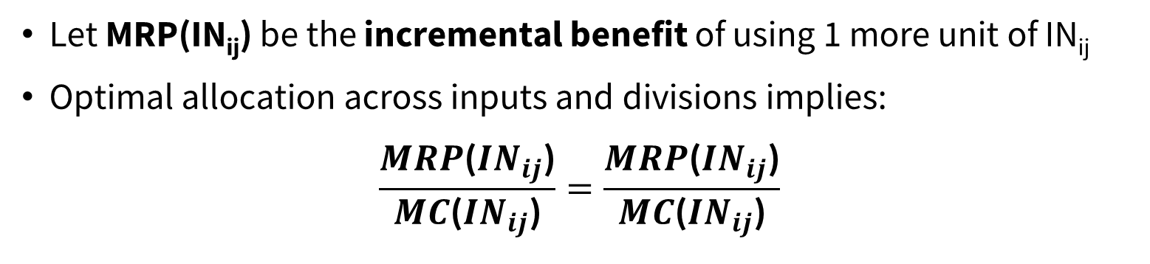
Optimal firm organization
Goal
Sam’s Club/Costco and Apple examples hint at how organizations should be structured
For each division, think about incremental value vs. incremental cost
Allocate inputs
Allocate resources (denoted by i) across divisions (denoted by j)
IN_{ij} would be an input i (e.g., labor, capital) used in division j (e.g., region, customer segment, product/brand)
Economic value added
Let MRP(IN_{ij}) be the incremental benefit of using 1 more unit of IN_{ij}
Optimal allocation across inputs and divisions implies:
$$\frac{MRP\text{(}{IN}_{ij}\text{)}}{MC\text{(}{IN}_{ij}\text{)}}=\frac{MRP\text{(}{IN}_{ij}\text{)}}{MC\text{(}{IN}_{ij}\text{)}}$$

Slide 66
Example: Outsourcing to China
It has been claimed that low wage countries like China have an inherent production advantage over high wage countries like the U.S.
Does this logic make sense?
How can we think about a firm’s decision to outsource?

Slide 67

Example: Outsourcing to China
When to outsource?
$$\frac{MRP\text{(}L_{China}\text{)}}{w_{China}}>\frac{MRP\text{(}L_{US}\text{)}}{w_{US}}$$
What affects MRP_{China} and MRP_{US}?
MRP_{i} = MP(L_{i})*MR(Q_{i})
If firms are selling in global market
MR_{China} = MR_{US}
So we really want to think about differences in marginal productivity
How will productivity and wages evolve in the U.S. and China in the future?

Slide 68
Outsourcing to China takeaways
Need to think carefully about what is driving value creation in each region
MRP of a worker is a function of
Incremental revenue driven by corporate strategy
Capital deployed per worker
Organizational incentives
Management quality
Worker quality
Skills and complementarity of other workers in the organization

Slide 69
Input price changes
How to respond?
How should a firm respond to changes in the prices of labor, capital, or other materials?
Examples
Supply of high-quality labor increases due to improvements in higher education and greater college enrollment rates
Leads to a decrease in equilibrium wages (w)
Interest rates increase, which raises the opportunity cost of capital
Leads to an increase in the real cost of capital (r)
Oil output restrictions by OPEC lead to increased energy prices
Re-optimize
How should firms re-optimize input choices in the short- and long- run in response to input price changes?

Slide 70
Input price changes
Suppose w ↑ to $20 (from $5), and your firm is still obliged to produce Q = 50
K
In the short run:
Isocost rotates in
K fixed at 5, so must keep L = 10
This is now more expensive
C = 20*10 + 10*5 = $250
In the long run:
The firm can re-optimize its L & K combination
It chooses L = 5 & K = 10
C = 20*5 + 10*10 = $200
10
5
Q = 50
5
10
L
Firm can make better adjustments to price changes in the long run (when it has more flexibility)

Slide 71
Output goal changes
Demand shifts out
When firm’s demand shifts outward, it will generally attempt to increase output
Firm chooses higher Q in response to higher MR
Examples
Begin shipping to a new market
Price of a complementary product decreased, which increases demand
How costly?
How costly is it to adjust an output goal?
Should a firm make a small or large output change as demand changes?

Slide 72
Output goal changes
Return to Q = LK, K = 5, w = 5, r = 10, C = $100
Now your firm must increase output from Q = 50 to Q = 80
Q = 50
Q = 80
In the short run:
K fixed at 5, so must increase L to 16
C = 5*16 + 10*5 = $130
K
In the long run:
Firm re-optimizes and chooses L = 12.65 & K = 6.3
C = 12.65*5 + 10*6.3 = $126.25
6.3
5
10
12.65
16
L
Again, the firm does better in the long run when it can adjust K

Slide 73
Agenda
Describing costs
Short-term costs
Long-term costs
Key cost types

Slide 74
Total, variable and fixed costs
For profit-maximizing output decisions, it’s convenient to illustrate a firm’s total, variable, and fixed costs
Total Cost (TC) = Variable Cost (VC) + Fixed Cost (FC)
In the short run, VC = wL and FC = rK
What are VC and FC in the long run?
Two important costs for output decisions:
Marginal cost (MC)
The change in costs as output increases by one unit
In the short run, this just depends on VC
Average cost (AC)
Cost divided by output (C/Q)
Important for whether a firm is profitable at a given price, P
If P ≥ AC, then yes
If P < AC, then no

Slide 75
Marginal cost and productivity
Recall that the “typical” case for marginal product of labor (MPL) is that MPL is hump-shaped
What does this imply about marginal costs?
MPL
MPL
L

Slide 76
Marginal cost and productivity
MPL = dQ/dL
Increase in output with a one-unit increase in labor
Invert to get dL/dQ = 1/MPL
Necessary labor for another unit of output is the inverse of MPL
MC = dC/dQ
Costs increase (in short run) only through variable cost (VC = wL)
How much do variable costs change when target Q increases by a unit?
Amount of additional labor necessary, multiplied by wage
Thus, MC = w x (dL/dQ) = w/MPL
Marginal cost is inversely related to productivity!
Less time is needed from more productive workers in order to increase output

Slide 77
Marginal cost and productivity
MPL eventually falls due to the law of diminishing returns (LDR)
MC falls as MPL rises, and then eventually rises due to LDR
Q
Cost
($)
MC
MPL
L
Q

Slide 78
Properties of marginal and average cost
Average cost (AC) is usually U-shaped in quantity
Includes both fixed and variable costs
MC cuts through AC at AC’s minimum point
Cost ($)
MC
AC
Q

Slide 79
Marginal cost and average cost
Optimal decisions
Together, MC and AC guide the firm to make optimal quantity decisions
Best Q > 0
Whether Q > 0 is wise at all
Time
MC and AC are defined in both the short and long run
Properties are determined by productivity and cost-minimization
Examples
When a firm cannot easily substitute L for K …
Short-run marginal costs will be steep in Q
Long-run average costs will always be below short-run average costs
Firm has more flexibility to achieve an output goal at lower cost

Slide 80


Total cost and average cost
Does not depend on Q
Total cost (TC(Q)) = Variable cost (VC(Q)) + Fixed cost (FC)
Average variable cost (AVC)
$$\frac{\text{VC}\text{(}\text{Q}\text{)}}{\text{Q}}$$
Average fixed cost (AFC)
$$\frac{\text{FC}}{\text{Q}}$$
Average total cost (AC)
AVC + AFC

Slide 81
Average cost and returns to scale
Cost
Increasing
returns
Decreasing
returns
At Q*, average total cost is minimized
At Q < Q*, increasing returns to scale
For Q > Q*, decreasing returns to scale
ATC
AFC
Q*
Output

Slide 82
Economies of scale and learning
Economies of scale
Average cost declines as output increases when measured within a given time period
Learning
Average cost declines as output increases when measured across time periods

Slide 83
Economies of scale and learning
Unit Cost
ATC₁
ATC₂
Learning effect
Output
Economies of scale

Slide 84
Economies of scope
Effect on costs of the number of activities in which the company is engaged
Joint products
Networks (rail)
Shared services (Alibaba)

Slide 85
Examples of behavioral biases: Costs
Sunk cost fallacy
Factoring in unrecoverable costs when making a decision
Focus on money or time already spent
Continue to fund project
“We might as well keep building the plant – we’ve already invested $2B”
Escalation of commitment
Investing additional resources to “catch up” even when all indicators point to a failure of continued investment
Investing additional resources to “fix” the problem
Ex: Vancouver ‘86 Expo’s initial budget of CND 78M ballooned to CND 1.5B, with multiple additional cash infusions

Slide 86
Summary of costs
“Right” kind of costs
Primary difference from accounting: opportunity and sunk costs
Short run minimization
Constrained choices
Generally expensive reactions to changing environments
Long run
Long run costs are lower than in the short run
Due to benefits of flexibility for a firm choosing all its inputs
Marginal costs
Determined through firm’s production technology and cost-minimizing input choices

